Slide 1
PROJECT PRESENTATION

Slide 2

MOVIE WEBSITE

Slide 3
MOTIVATION BEHIND THE PROJECT:
MOVIES ARE PERFECT STRESS BUSTER FOR MOST OF US AND WITH NEW MOVIES COMING IN EVERYDAY, WE NEED A WEBSITE THAT CURATES THINGS FOR US. THIS IS THE MAIN MOTO OF CREATING A MOVIE WEBSITE SO THAT WE GET ALL THE NEW RELEASED MOVIES AT ONE PLACE. BE IT BOLLYWOOD MOVIES OR SOUTH INDIAN MOVIES OR THE TRENDING OTT HITS, YOU WILL GET EVERYTHING ON THIS WEBSITE WITH THE LINK OF TRAILERS ATTACHED TO IT, SO THAT YOU GET TO CHOSE WHICH ONE TO GO WITH.

Slide 4
DEVELOPMENT DETAILS:
THIS WEBSITE IS DEVELOPED USING HTML,CSS AND JAVASCRIPT. JAVASCRIPT HAS BEEN USED TO FACILITATE FEATURES LIKE DARK MODE AND SCROLLING ARROW. THE WESITE OFFERS OPTIMISIZED VIEW FOR EVERY DEVICE.

Slide 5
SERVICES PROVIDED:
THE WEBSITE PROVIDES SERVICE TO VIEW THE RECENTLY RELEASED MOVIES OF BOLLYWOOD, HOLLYWOOD, TOLLYWOOD AND OTT. IT ALSO PROVIDES OPTION TO VIEW TRAILER OF THE MOVIES USING A WATCH BUTTON WHICH REDIRECTS TO THE YOUTUBE LINK OF THE MOVIE’S TRAILER.

Slide 6
DATA REQUIREMENTS:
DATA REQUIREMENTS FOR THE WEBSITE ARE THE POSTERS OF THE MENTIONED MOVIES AND THE LINK TO THE MOVIES’ TRAILER. THE FIRST REQUIREMENT HAS BEEN FULFILLED USING THE POSTERS FROM THE WEBSITE OF IMDB AND THE SECOND HAS BEEN FULFILLED USING THE YOUTUBE LINK.

Slide 7
FUTURE ASPECTS OF THE WEBSITE:
FEW MORE OPTIONS CAN BE ADDED TO THE WEBITE AS FUTURE DEVELOPMENT, THE HINT OF WHICH, IS GIVEN IN THE SIDEBAR OF THE WEBSITE. WE CAN ADD AN OPTION TO BUY OR RENT MOVIES DIRECTLY FROM THE WEBSITE. A STREAMING OPTION CAN ALSO BE ADDED TO THE WEBSITE WHICH WILL FACILITATE PEOPLE TO DIRECTLY STREAM MOVIE ON THE WEBSITE.WE CAN ALSO ADD A LOGIN PAGE TO THE WEBSITE SO THAT INDIVIDUALITY IS MAINTAINED.

Slide 8

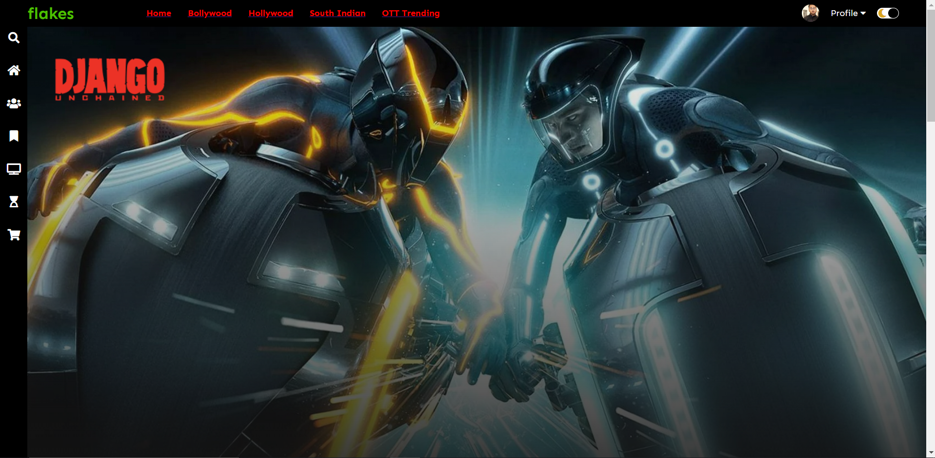
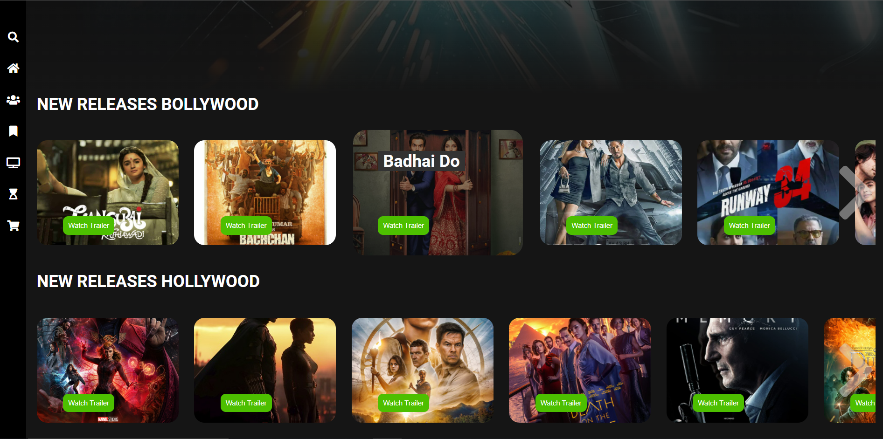
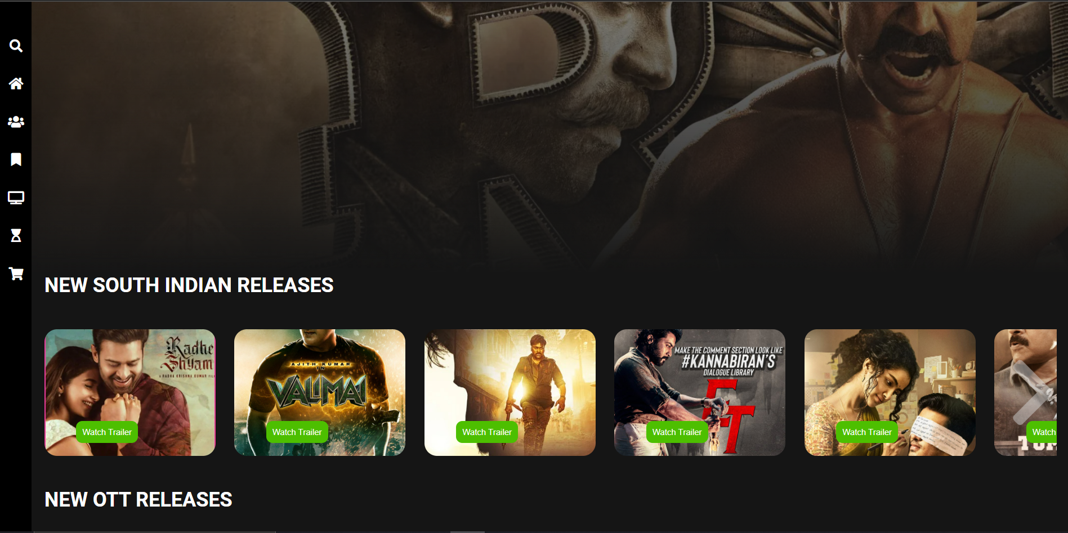
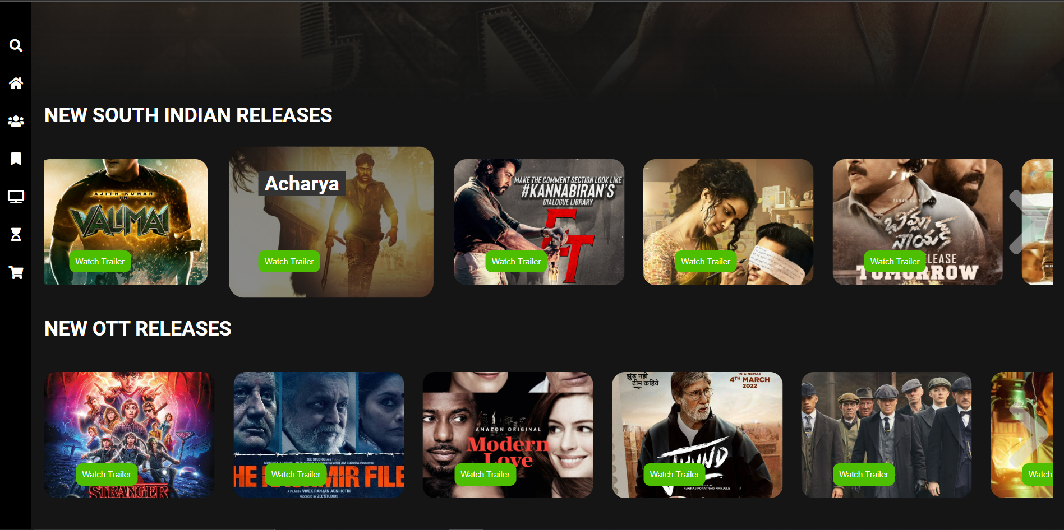
SNAPSHOTS

